Slide 1

- Basic logical thinking -
1
Notes:
1

Slide 2
Purpose and target
Purpose
･To understand basic logical thinking through speaking and hearing.
･To understand the foundation of the problem-solving thought.
Target
･To understand basic logical thinking and logical communications.
2
Notes:
2

Slide 3
Outline
1.What is logical thinking?
2.Deductive method and inductive method
3. "Inquiry" trains our thinking ability
4.MECE
5.Pyramid structure
6.PREP method
3
Notes:
3

Slide 4

1.What is logical thinking?
What is the meaning of logical thinking?
logical thinking is to think methodically and reasonable objectively.
①There is a clear insistence.
②The insistence has grounds.
③Grounds correctly support the insistence.
Argumentative means reasonable self-satisfying.
< non-logical > "Let's do this" → "Because it’s my own way.”
< logical > "Let's do this" → ｢?｣
4
Notes:
4

Slide 5


1.What is logical thinking?
Uses of logical thinking
･Communications
persuasion, negotiation, guidance, hearing, presentation
etc...
･Information gathering
･Analysis
･Document creation
･Problem solving
･Promotion
5
Notes:
5

Slide 6
1.What is logical thinking?
If logical thinking doesn’t exist…
Example ① subordinate was late
“To come late is forbidden. Have no reason. “
Example ② candidate is worrying
“Do this. Because I did so before.”
Example ③ business explanation
"Please try this for now. "
6
Notes:
6

Slide 7
2.Deductive method and inductive method
Deductive method
Deductive method is to associate more than two rules or premises, and then,
derive the conclusion from it. So-called, it’s syllogism.
【 Major premise 】The sunblock is effective for the sunburn prevention.
【 Conclusion 】The sunblock is effective for me.
【 Minor premise 】I do not want to sunburn.
【 Conclusion 】The logical thinking is necessary to me.
【 Major premise 】The logical thinking is necessary to SE.
【 Minor premise 】I am SE.
7
Notes:
7

Slide 8
2.Deductive method and inductive method
Exercise 1
①Write the sentences in the column of the following 【 Minor premise 】 and 【 Conclusion 】 , and complete the deductive method. (three minutes)
②Let's share the content mutually with the nearby person. (three minutes)
【 Major premise 】
It is said that the animals start to make a noise before the natural disaster happens.
【 Conclusion 】
【 Minor premise 】
8
Notes:
8

Slide 9
2.Deductive method and inductive method
inductive method
inductive method is to derive the rule from common feature of more than two events.
【 Case 】Cool Biz has spread in Tokyo.
【 Conclusion 】
Cool Biz has spread in urban area.
【 Case 】Cool Biz has spread in Nagoya
【 Case 】Cool Biz has spread in Osaka.
【 Case 】Recently, we can see a lot of pet shops.
【 Conclusion 】
Recently, the business concerning the pet seems to have increased.
【 Case 】Recently, the number of inns that we can bring pets into is increasing.
【 Case 】Recently, we can see a lot of restaurants that we can bring pet's into.
9
Notes:
9

Slide 10
2.Deductive method and inductive method
Exercise 2
①Write the sentences in the column of the following 【 Case 】 by each one, and complete the inductive method. (three minutes)
②Let's share the content mutually with the nearby person. (three minutes)
【 Case 】
【 Conclusion 】
The animals tend to start make a noise before the natural disaster happens.
【 Case 】
【 Case 】
10
Notes:
10

Slide 11
2.Deductive method and inductive method
Relation between deductive method and inductive method
inductive method
【 Case 】Mr. A was able to prevent sunburn by the sunblock.
【 Case 】Mr. B was able to prevent sunburn by the sunblock.
【 Conclusion 】The sunblock is effective for the sunburn prevention.
【 Case 】Mr. C was able to prevent sunburn by the sunblock.
Deductive method
【 Major premise 】The sunblock is effective for the sunburn prevention.
【 Conclusion 】The sunblock is effective for me.
【 Minor premise 】I do not want to sunburn.
?
11
Notes:
11

Slide 12
2.Deductive method and inductive method
Relation between deductive method and inductive method
inductive method
【 Case 】Mr. A succeeded in dieting by aerobics.
【 Case 】Mr. B succeeded in dieting by aerobics.
【 Conclusion 】Aerobics are effective in dieting.
【 Case 】Mr. C succeeded in dieting by aerobics.
Deductive method
【 Major premise 】Aerobics are effective in dieting.
【 Conclusion 】Let’s start aerobics.
【 Minor premise 】I should diet.
inductive method
【 Case 】I am kind of fat recently.
【 Conclusion 】I should diet.
【 Case 】It is said that overweight too much is bad for the health.
【 Case 】It is necessary to buy new clothes when we gain weight.
12
Notes:
12

Slide 13
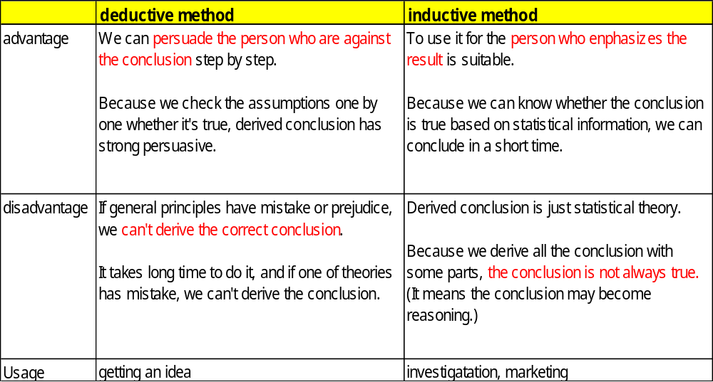
2.Deductive method and inductive method
Difference between deductive method and inductive method
Our thinking method has two kind.
13
Notes:
12

Slide 14
3. "Inquiry" trains our thinking ability.
" Grounds" that support "Insistence” is necessary for logic.
The person doesn't consent, and not act if the reason is not clear.
Moreover, it doesn't become an essential problem solving.
Logic: "I will start aerobics."
Grounds: "Because aerobics are effective. And I need to diet."
- Whether it's logical is whether we can answer against inquiry properly.
“Inquiry“ trains our thinking ability.
14
Notes:
14

Slide 15
3. "Inquiry" trains our thinking ability.
Think about all the inquiries.
In the scene of business …
"Please adopt this project idea. "
Because...
･
･
･
･
･
It is an idea that I considered by staying up all night.
It is an idea with a high evaluation in our company.
My evaluation goes up if it is adopted.
The design is innovative.
All your various conditions are cleared.
- These are just examples. Actually, we need to list grounds that counterpart is satisfied with.
15
Notes:
15

Slide 16
3. "Inquiry" trains our thinking ability.
Exercise 4
Please list “Inquiries”to the following insistences as many as possible. (four minutes)
Why? Why? Why? Keep thinking.
“It takes a long time to remember business for new employees. "
Because..
･
･
･
･
16
Notes:
16

Slide 17
4.MECE
MECE means..Mutually Exclusive and Collectively Exhaustive. The meaning is thoroughly and not overlapped. It is pronounced, “Me see".
Why is MECE necessary?
･Scene of persuasion/guidance
… It is necessary to remove the doubt "Is it really so?" and “That's it?" when the counterpart understands things, and because MECE is effective to the latter .
･Scene of problem solving
… Because if we don't think things by MECE, we can't resolve the problems essentially.
17
Notes:
17

Slide 18
4.MECE
Japanese
Vietnamese
Person who can speak Japanese
Person who can speak English
Minority
Adult
These are duplications.
There are people who can speak both.
These are omission.
There are people who can speak neither.
We cannot see duplication and omission.
Vietnamese
Can speak Japanese.
Can speak English.
Another person
Family
e.g.) We think Vietnamese land by MECE..
We cannot see duplication and omission.
Saigon
The north
Vietnam
Dong Nai
The south
Bien Hoa
…
…
18
Notes:
18

Slide 19
4.MECE
Exercise 5
Hereafter, is it MECE? Think it whether it is MECE.
①A man and woman
②Member of society and students
③Domestic travel and overseas travel
19
Notes:
19

Slide 20
4.MECE
Exercise 6
①Please divide "School" into MECE.
②Please divide "Car" into MECE.
20
Notes:
20

Slide 21
4.MECE
How do you make it to MECE? 1/4 → (A) and (NOT A)
We have no budget.
…
There is no training course.
We have a budget.
Employee's business manners are bad.
…
There is
training
course.
Training course has problems.
…
Training course doesn't have problems.
…
21
Notes:
21

Slide 22
4.MECE
How do you make it to MECE? 2/4 → calculating formula
The number of users are decreasing?
Sales of the shop is decreasing.
Per-use of the user are decreasing?
The average unit price per a user is decreasing?
22
Notes:
22

Slide 23
4.MECE
How do you make it to MECE? 3/4 → process
Making an appointment
Business talk
Visit
Estimate
Order
23
Notes:
23

Slide 24
4.MECE
How do you make it to MECE? 4/4 → framework
｢3C｣
･Customer
･Competitor
･Company (ourselves)
｢QCD｣
･Quality
･Cost
･Delivery (delivery date)
｢4P｣ of marketing
･Product
･Price
･Place (channel)
･Promotion
｢SWOT｣
･Internal factor: strong point
and weakness
･External factor: chance
and threat
24
Notes:
24

Slide 25
5.Pyramid structure
Pyramid structure means..
It is used to make a logical structure from the integration of each messages by the interpretation in communications.
25
Notes:
25

Slide 26
5.Pyramid structure
Image of pyramid structure
MECE
(However, we don't have to mak it perfect MECE. )
Why so?
Conclusion
So what?
(deductive method
/inductive method)
Why so?
So what?
(induction
method)
Grouping
26
Notes:
26

Slide 27
5.Pyramid structure
Image of pyramid structure
Why so?
The sunblock is necessary for me.
So what?
(deductive method
/inductive method)
The sunblock is effective for the sunburn prevention.
I do not want to sunburn.
Why so?
Mr. A was able to prevent sunburn by the sunblock.
Mr. B was able to prevent sunburn by the sunblock.
Mr. C was able to prevent sunburn by the sunblock.
It becomes a bristletail when sunburning.
I am unpleasant in becoming the bristletail.
So what?
(induction
method)
27
Notes:
27

Slide 28
5.Pyramid structure
Image of pyramid structure
Why so?
Let's start aerobics
So what?
..(.. deductive method
/induction)
Aerobics are effective in dieting.
I should diet.
Why so?
So what?
..(.. induction
/induction)
Mr. A succeeds in dieting in aerobics.
Mr. B succeeds in dieting in aerobics.
Mr. C succeeds in dieting in aerobics.
I am kind of fat recently.
It is said that overweight too much is bad for the health.
It is necessary to buy new clothes when we gain weight.
28
Notes:
28

Slide 29
6.PREP method
PREP method … The simplest, effective technique to talk about "It is comprehensible", "The reason is set up", and "A surrounding person can be persuaded" based on the pyramid structure of logic.
Point :Point, insistence, and conclusion
Reason : The reason
Example: Case and data
Point : Conclusion, summary, and Repetition of the first P
29
Notes:
29

Slide 30
6.PREP method
Point: “I will start aerobics because I am kind of fat recently. "
Reason: “Because aerobics is effective to dieting."
Example: "All of my acquaintances who succeeded in dieting were doing aerobics. "
Point: "Therefore, I will start aerobics. "
30
Notes:
30

Slide 31
6.PREP method
Example)
P: I like dogs.
R: Because it's intelligent, and it's useful for us.
E: For example, "There are dogs such as the police dogs and the drug investigation dogs the guide dog, the guide dog for the deaf, and the service dog."
P: Because it's useful, I like it. "
Example) In the scene of business …
P: We recommend this product. "
R: Because it is the most suitable for your needs.
E: Because it is small, you can use your room widely. And the function is also enough for the demand.
P: We will recommend this product for the above-mentioned reasons.
31
Notes:
31

Slide 32
6.PREP method
Exercise 7
Write the sentences into the following empty columns by each one, and complete the PREP method (for four minutes)
Point: "I will recommend the friend to join IBS Vietnam. "
Reason: "
"
Example: "
"
Point: " Therefore, I will recommend the friend to join IBS Vietnam. "
32
Notes:
32

Slide 33
6.PREP method
Exercise 8 (question)
Please correct the following sentences based on the PREP method (for three minutes)
Because I experienced as the last person in charge of the previous event. The part-time job was not able to be arranged sufficiently because the budget was not enough last time. I think it is difficult in this budget this time.
33
Notes:
33

Slide 34
6.PREP method
Exercise 8 (example answer)
Please correct the following sentences based on the PREP method (for three minutes)
Because I experienced as the last person in charge of the previous event. The part-time job was not able to be arranged sufficiently because the budget was not enough last time. I think it is difficult in this budget this time.
In this budget, I think it is difficult. I think so based on the experience of last time. Because the budget was not enough, I was not able to arrange the part-time job efficiently though I was charge of the event last time. Therefore, I think it is difficult in this budget.
34
Notes:
34

Slide 35
6.PREP method
Exercise 9 (question)
Please correct the following sentences based on the PREP method (for three minutes)
Let's decide this travel plan. If it is this plan, an elderly person can soak in the hot spring, and the young person can enjoy doing sports. This plan is good because there is an amusement park also for the child.
35
Notes:
35

Slide 36
6.PREP method
Exercise 9 (example answer)
Please correct the following sentences based on the PREP method (for three minutes)
Let's decide this travel plan. If it is this plan, an elderly person can soak in the hot spring, and the young person can enjoy doing sports. This plan is good because there is an amusement park also for the child.
Let's decide this travel plan. If it is this plan, different generation's people can also enjoy it respectively. An elderly person can soak in the hot spring, and the young person can enjoy doing sports. There is an amusement park for the child. Because it is possible to enjoy it like this widely, this plan is good.
36
Notes:
36

Slide 37
6.PREP method
Scene which PREP method is unsuitable
①When we make a request that troubles counterpart.
②When we describe the answer and the idea that counterpart don't prefer.
③When we tell the matter without the shared understanding
37
Notes:
37

Slide 38
Purpose and target
Purpose
･To understand basic logical thinking through speaking and hearing.
･To understand the foundation of the problem-solving thought.
Target
･To understand basic logical thinking and logical communications.
38
Notes:
2

Slide 39
Making Action Plan
Make your concrete action plan based on the thing you studied in this contents. Please report it to managers within three working days.
I studied some methods in this training..
What?
Where? (scene)
Until what time? (deadline)
I will act based on above thing.
39
Notes:
39

